Slide 1

AI Engineer Agentic Track
The Complete
Agent & MCP
Course
Week 2
Day 3

Slide 2
Week 6: MCP
Agentic
Architecture
and MCP
Building an
MCP Server
and Client
Multiple Local
and Remote
MCP servers
Project 8: AI
Equity Traders
Project 8: AI
Equity Traders
In Action
Week 5: Agent Frameworks
Google ADK and A2A
AWS Strands Agents
Other Python Frameworks
JS/TS Frameworks
Project 7:
Agent
Loop
Week 4: LangGraph
Understand
LangGraph
concepts
Build a
LangGraph
Agent
Tools, memory,
web searches
Project 6:
Sidekick
Project 6:
Sidekick
improvements
Week 3: CrewAI
Understand
Crew AI
Concepts
Build a Crew
Agent
Project 4: Stock
Picker
Project 5:
Developer
Agent
Project 5:
Engineering
Team
Week 2: OpenAI Agents SDK
Understand
OpenAI Agents
SDK concepts
Project 2: an
SDR
Tools vs Agents
Guardrails
Project 3: Deep
Research
Project 3: Deep
Research app
Week 1: Foundations
Make an
Agentic
Workflow
Agents and
Agentic
Patterns
Orchestrating
LLMs
Autonomy and
Tools
Project 1:
Your personal
career agent

Slide 3
Recap: Orchestration
The ways that Agents can collaborate:
Orchestrating Agents with Code
Orchestrating Agents with LLMs - Tools
Orchestrating Agents with LLMs - Handoffs

Slide 4



Adding to the mix
Models other
than OpenAI
Structured
Outputs
Guardrails
And 2 special extras: Sandbox & MCP!

Slide 5

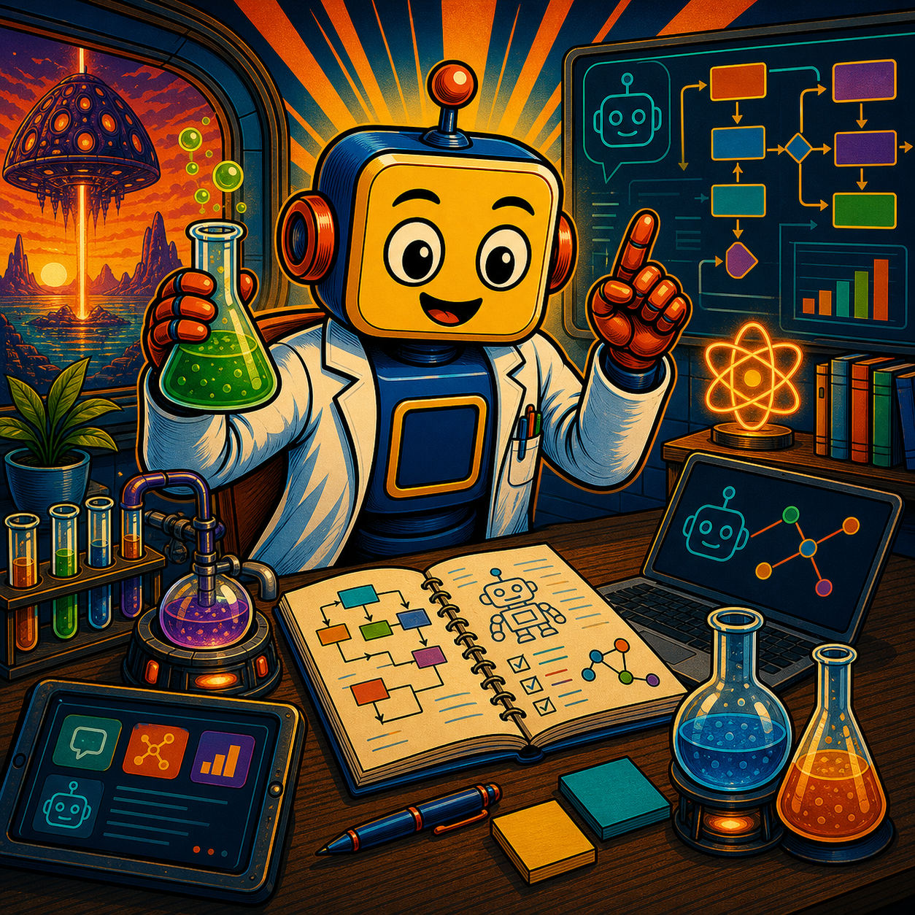

Slide 6
Week 6: MCP
Agentic
Architecture
and MCP
Building an
MCP Server
and Client
Multiple Local
and Remote
MCP servers
Project 8: AI
Equity Traders
Project 8: AI
Equity Traders
In Action
Week 5: Agent Frameworks
Google ADK and A2A
AWS Strands Agents
Other Python Frameworks
JS/TS Frameworks
Project 7:
Agent
Loop
Week 4: LangGraph
Understand
LangGraph
concepts
Build a
LangGraph
Agent
Tools, memory,
web searches
Project 6:
Sidekick
Project 6:
Sidekick
improvements
Week 3: CrewAI
Understand
Crew AI
Concepts
Build a Crew
Agent
Project 4: Stock
Picker
Project 5:
Developer
Agent
Project 5:
Engineering
Team
Week 2: OpenAI Agents SDK
Understand
OpenAI Agents
SDK concepts
Project 2: an
SDR
Tools vs Agents
Guardrails
Project 3: Deep
Research
Project 3: Deep
Research app
Week 1: Foundations
Make an
Agentic
Workflow
Agents and
Agentic
Patterns
Orchestrating
LLMs
Autonomy and
Tools
Project 1:
Your personal
career agent

Slide 7

AI Engineer Agentic Track
The Complete
Agent & MCP
Course
27%
Complete

